Slide 1


QBR Q3 2023
Wednesday, August 9th
Jared Bruley | Christin DeLuzio

Slide 2

Agenda
Dates/Location/Registration Goals
Planning Committees
Color Palette & Event Themes
Steering Committee
Opening Reception
Sponsorships
Keynote & Emcee
Registration Launch Timeline
  Communications Plan | Pricing Structure | Upcoming Assets

Slide 3
EVENT DATES:
Wednesday, May 15 – Friday, May 17
Omni Orlando Resort at ChampionsGate | Orlando, FL

Slide 4

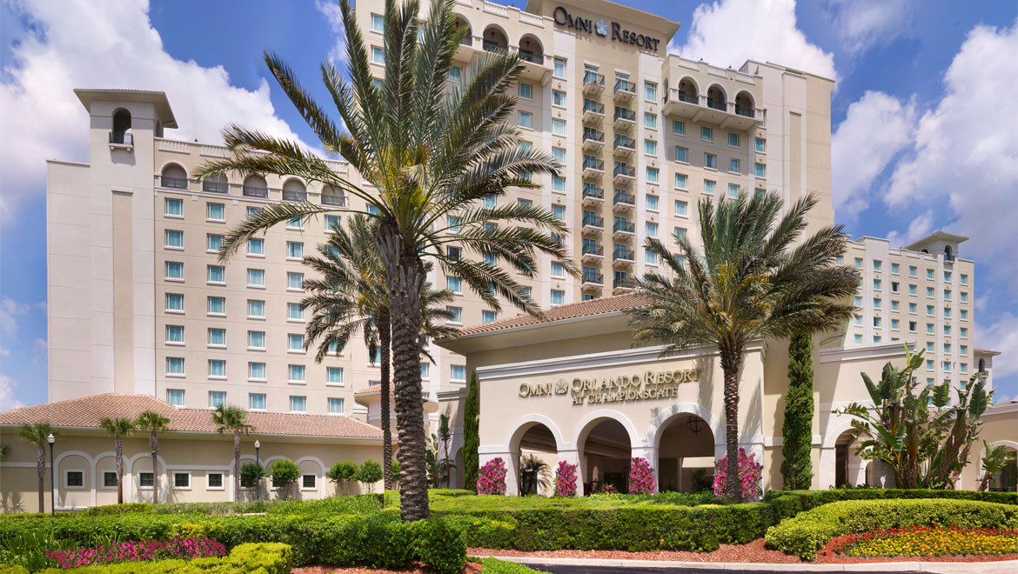
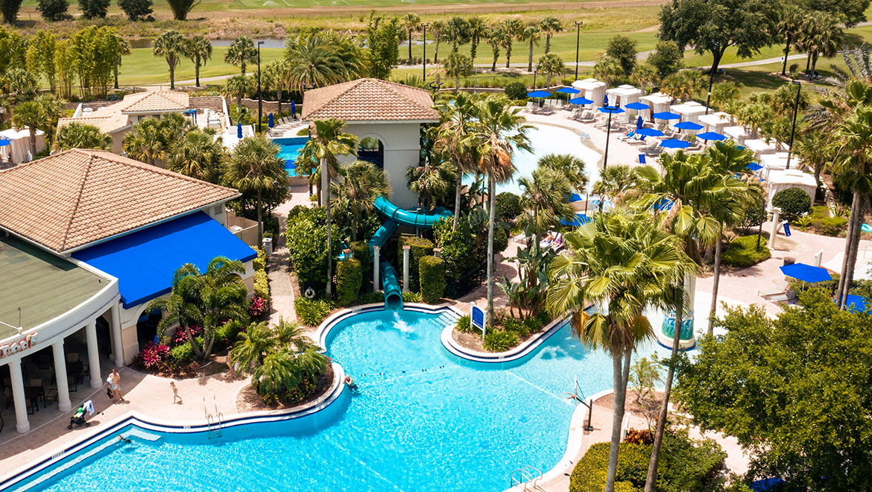
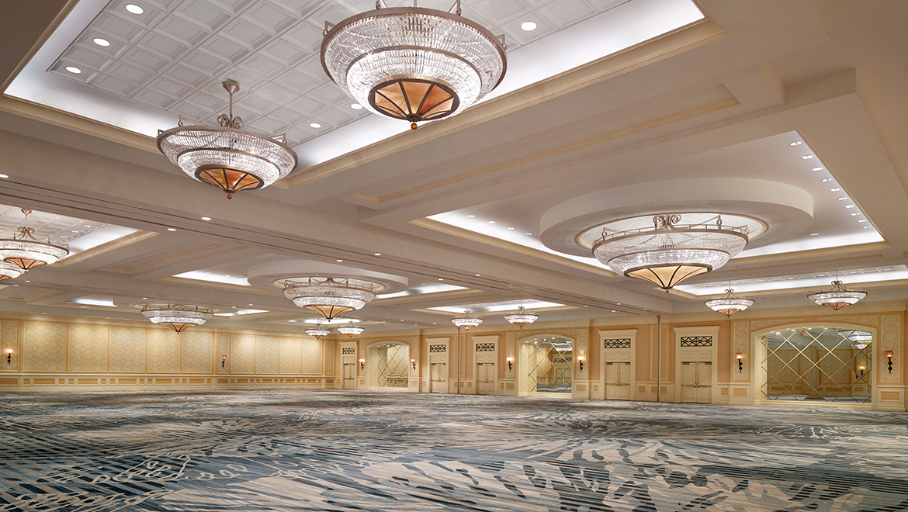
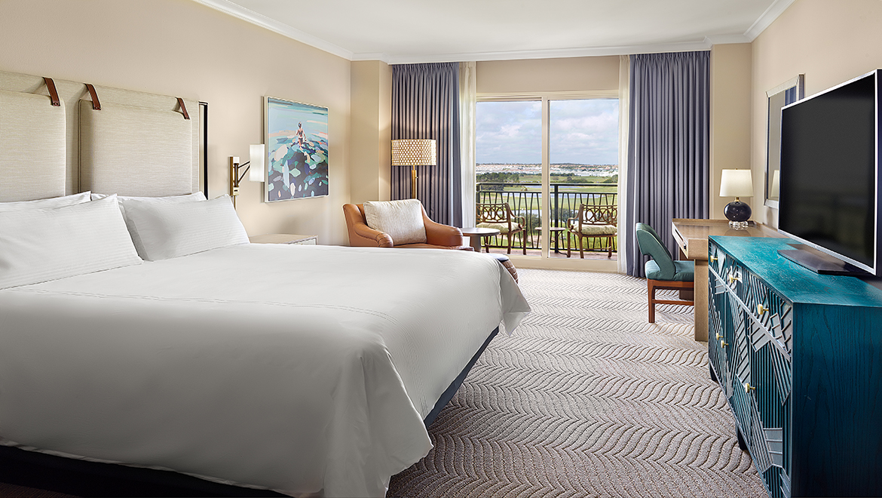
Omni Orlando Resort at Championsgate

Slide 5


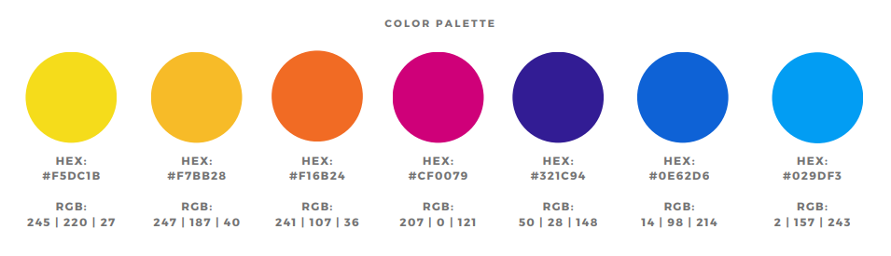

Color Palette/Branding

Slide 6
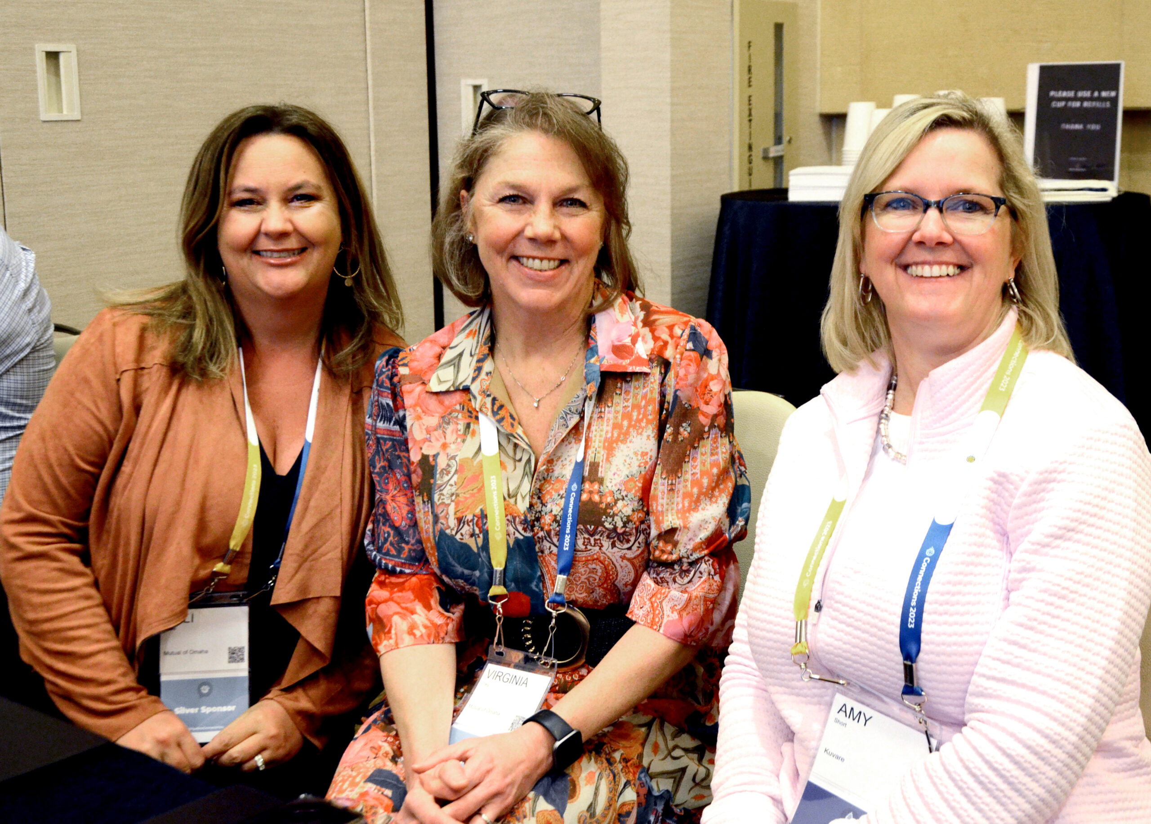
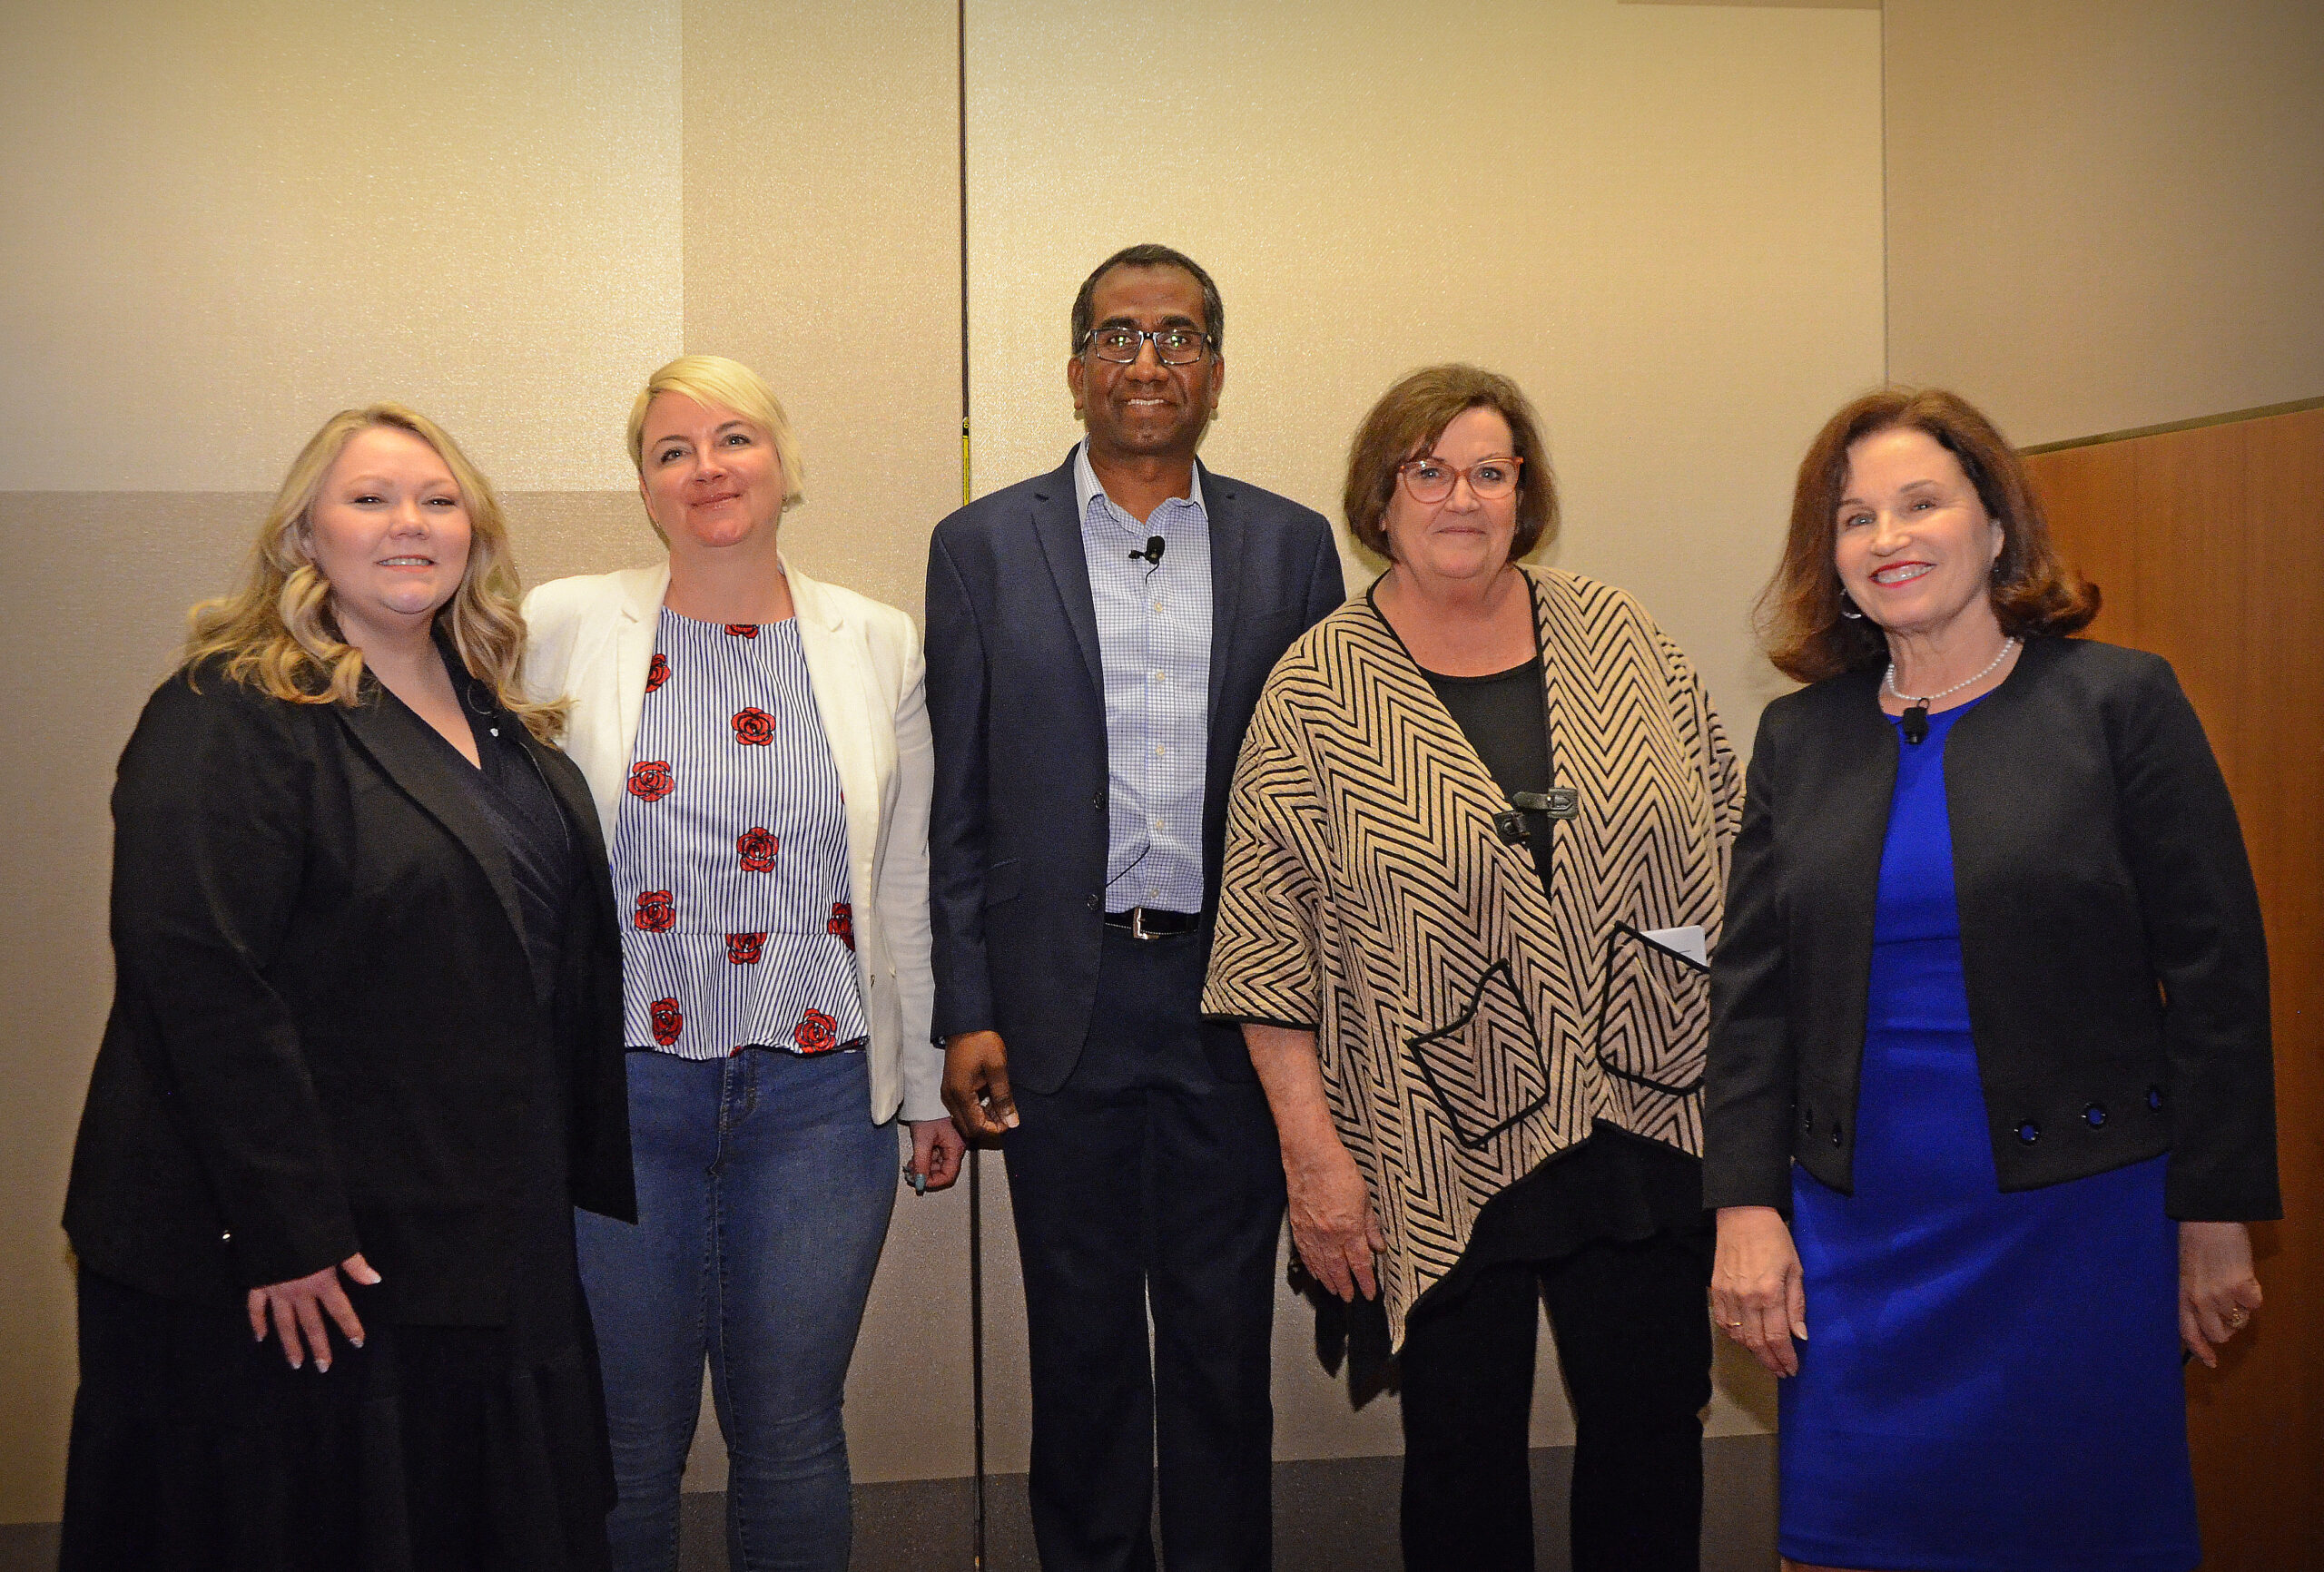
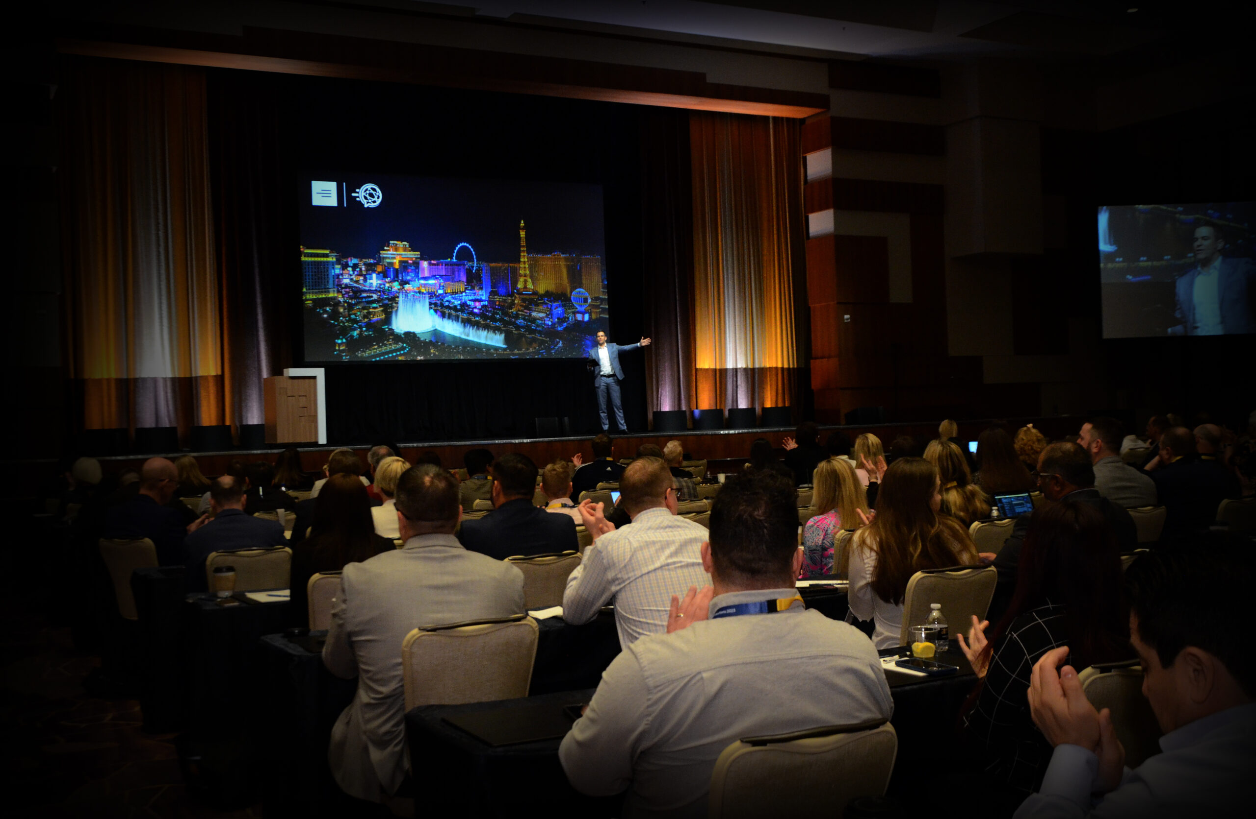
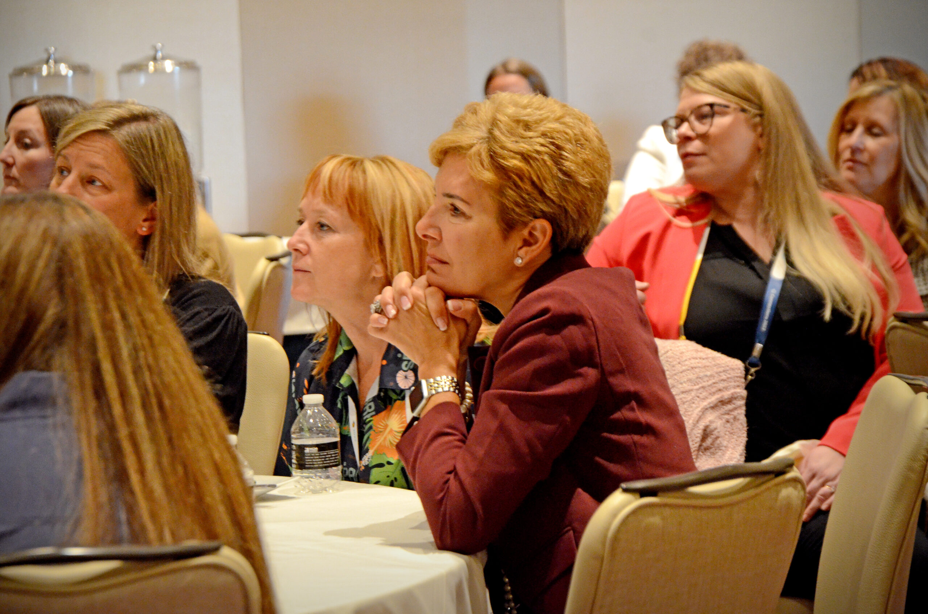
Connections 2024 Themes | Internal Use
Partnering with our clients to solve their most complex business challenges through our network of digital, market-leading, secure, and innovative solutions for the Life Insurance, Financial Services, and Wealth Management industries.
Continued investment in our end-to-end technology to empower digitization and reduce the overall use of paper, showcasing our dedication to social and environmental activities.
29 years of experience, strong financial backing, and a dedicated focus on our deep client relationships, providing them lifetime support in their digital journey to protect more families.
1
2
3

Slide 7
2024 Planning Committees
Christin DeLuzio | Sr. Event & Engagement Consultant

Slide 8
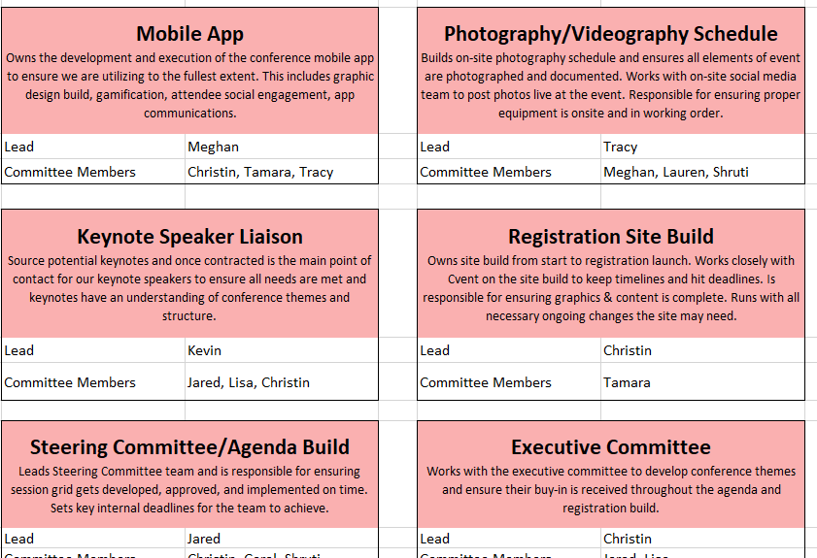
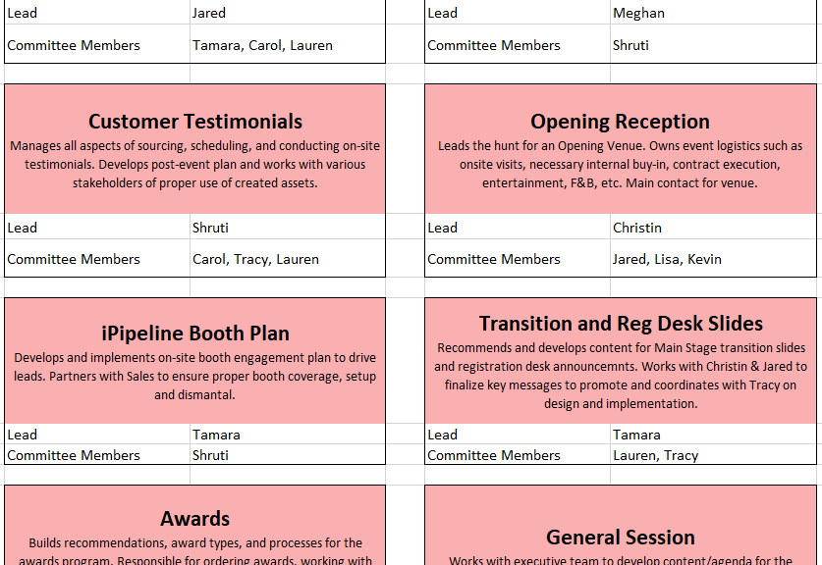
Planning Committees
Sub-Committees internal to the Marketing/Event Team with the purpose of delegating ownership on all conference segments.
Communications
Exhibitor Reception
Employee Relations
Customer Testimonials
Opening Reception
Sponsorships
iPipeline Booth Plan
Transition Slides
Awards
PR
Executive Committee
General Session
Conference Structure
Mobile App
Video/Photo Schedule
AV
Keynote Speakers
Registration Site Build
Creative/Branding
Steering Committee/Agenda
Presentation Reviews
Post Event

Slide 9
2024 Steering Committee
Jared Bruley | Director of Channel Marketing

Slide 10
2024 Steering Committee
GOAL:
Build, develop, drive, and recommend industry-thought leader breakout session content and expand the number of customer speakers, industry presenters, and experts to present at Connections 2024.
KEY RESPONSIBILITIES:
  Develop and recommend 2024 breakout session topics and session presenters
    Work with SMEs (internally and externally) to develop relevant breakout session content
    Build sessions focused on thought-provoking content, thought leadership, and industry trends
      Content should NOT be product pitches or commercials
    Development includes session title, description, recommended iPipeline presenter(s) and guest presenter(s)
  Ensure speakers are confirmed (once recommendations have been approved)
  Support presenters for Presentation Review Process (February – April)
  Assist in collecting presentation assets
EXPECTATIONS:
  Think outside the box and HAVE FUN building session topics
  Leverage feedback from 2023 to optimize/improve session feedback
  Attend all committee meetings and be an active participant

Slide 11
Responsibilities, Expectations, and Phases
PHASE ONE: Session Build, Executive Approval, Registration Launch Prep
July 2023 – September 2023
  Build and recommend conference breakout session agenda
    Session Titles | Session Descriptions | Recommended Presenters (iPipeline/Customers/Partners)
PHASE TWO: Session Prep & Content Development
November 2023 – April 2024
  Ensure Speakers are Confirmed | Support Presenters for Presentation Review Process | Collect Assets
PHASE THREE: Post-Event Recap, Feedback, and Analysis
June 2024
  Steering Committee Feedback on Process | Suggestions for 2025 | Post-Event Report

Slide 12
Committee Members by Track/Area of Focus
LIFE: Carrier
Joe Paddock – Team Leader
Korey Barker
Greg Becker
Shawn Crumley
Carly Fetzer
Tom Hewitt
Andrew Higgins
Greg Levins
Jason Marcantelli
Conor O’Neill
Carissa Osgood
Rachel Quigley
Marcy White
Leo Davelman
LIFE: BGA
Serena Sanders – Team Leader
Matthew Lust
James Searer
Katrisha Wallace
Andy Stengel
ANNUITIES
Adam Ducorsky – Team Leader
Chuck Fox
Andrew McMorris
Joe Paddock
Rimma Polissky
Bobby Powell
WEALTH
Bobby Powell – Team Leader
Kevin Brown
Niharika Goyal
Sean Pope
Adam Ducorsky

Slide 13
2024 Opening Reception
Jared Bruley | Director of Channel Marketing

Slide 14

What We Look to Accomplish:
Grow Connections attendance, increase sponsorships, remain budget conscious and within previous year budget ($525,000)
Fully leverage new event location (FL) and create a “wow” experience
Do something completely different and utilize key aspects of Orlando
Find indoor/outdoor space to leverage Orlando and provide options for weather/heat

Slide 15

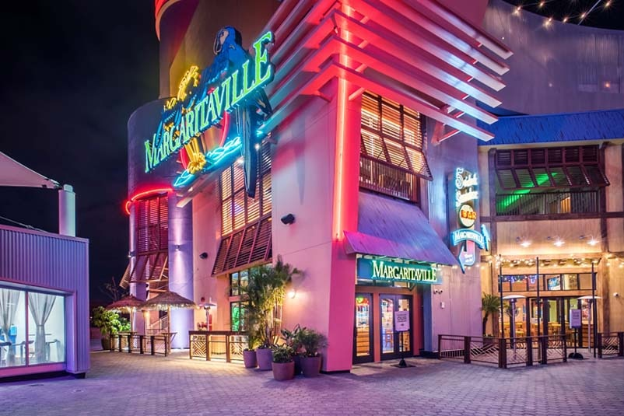
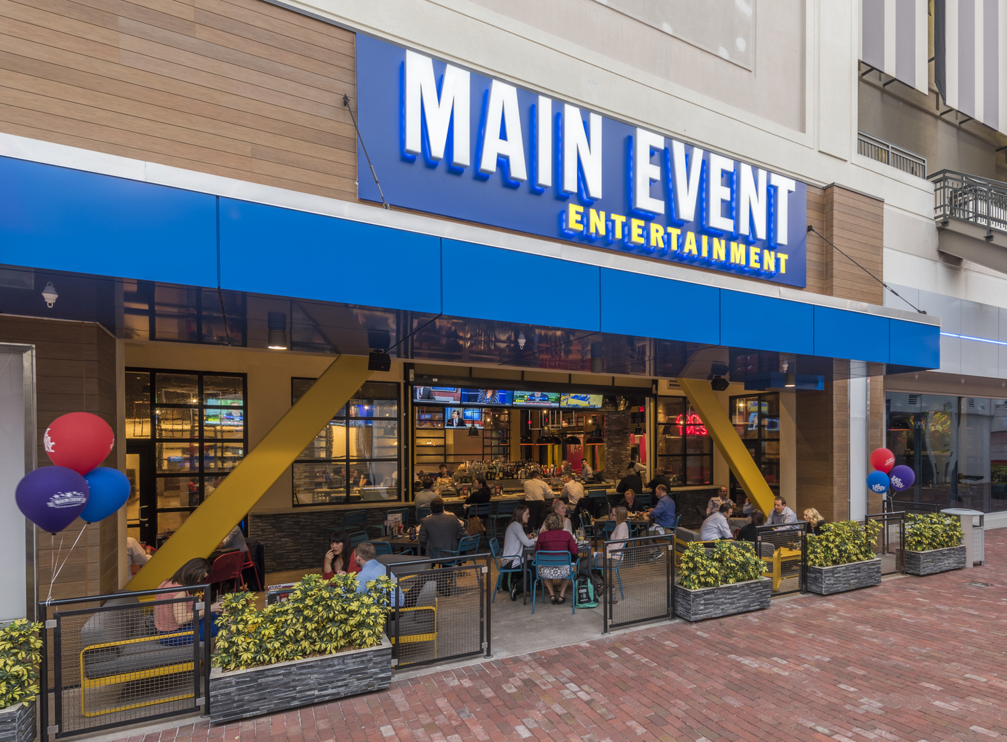
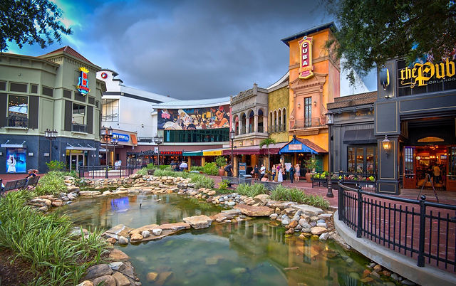
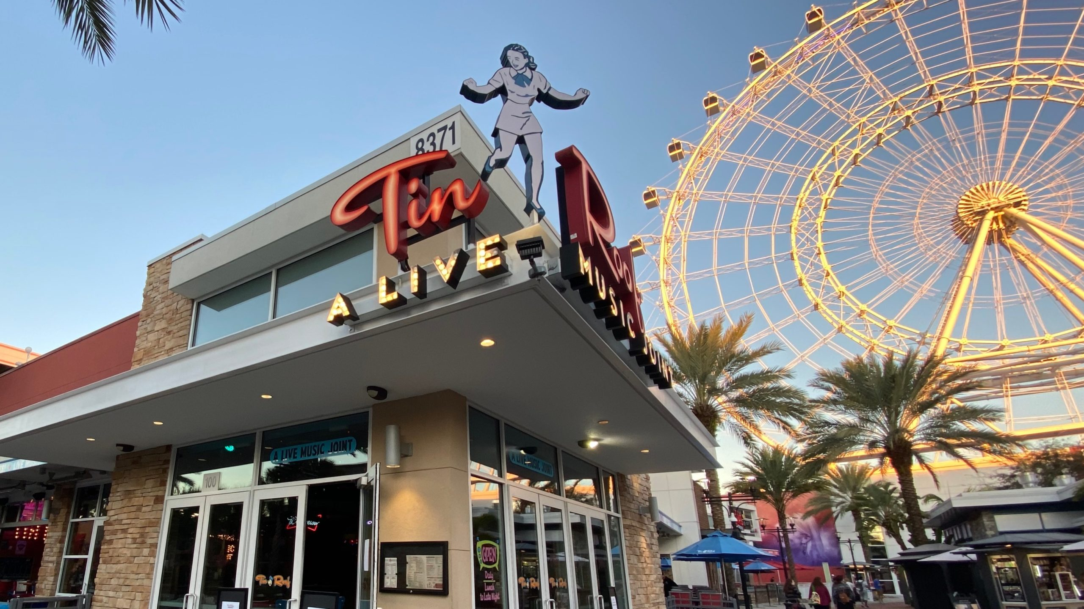
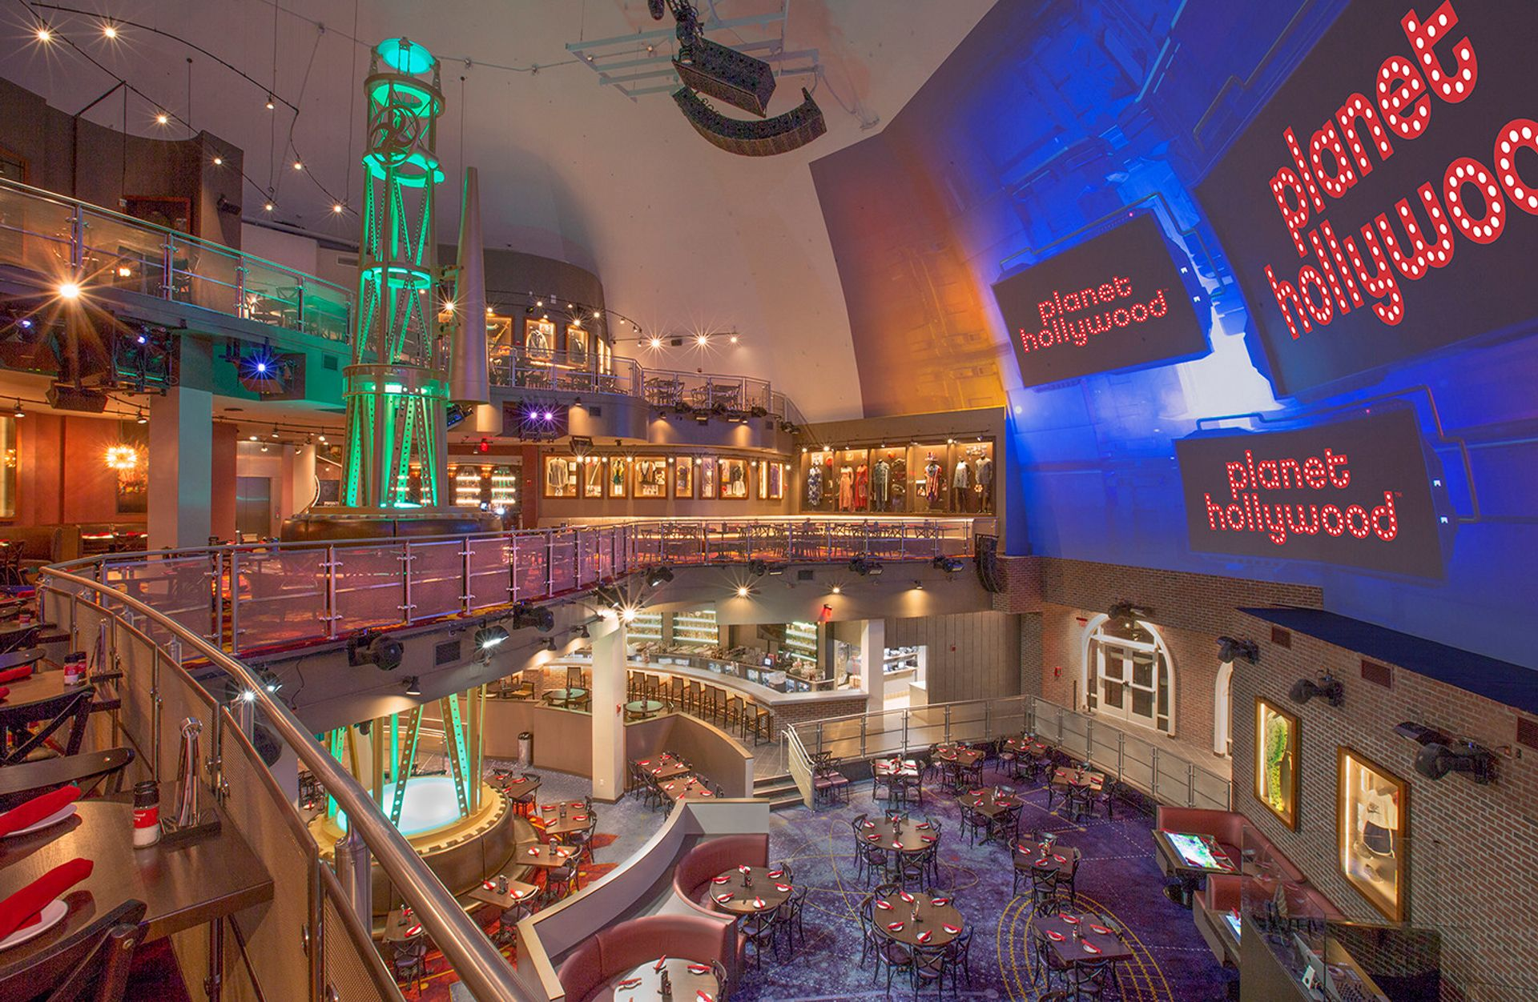
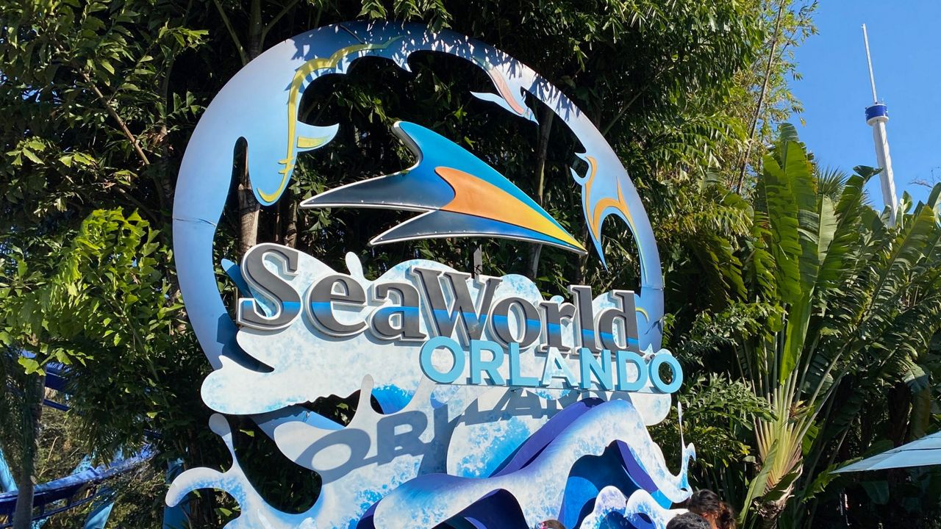
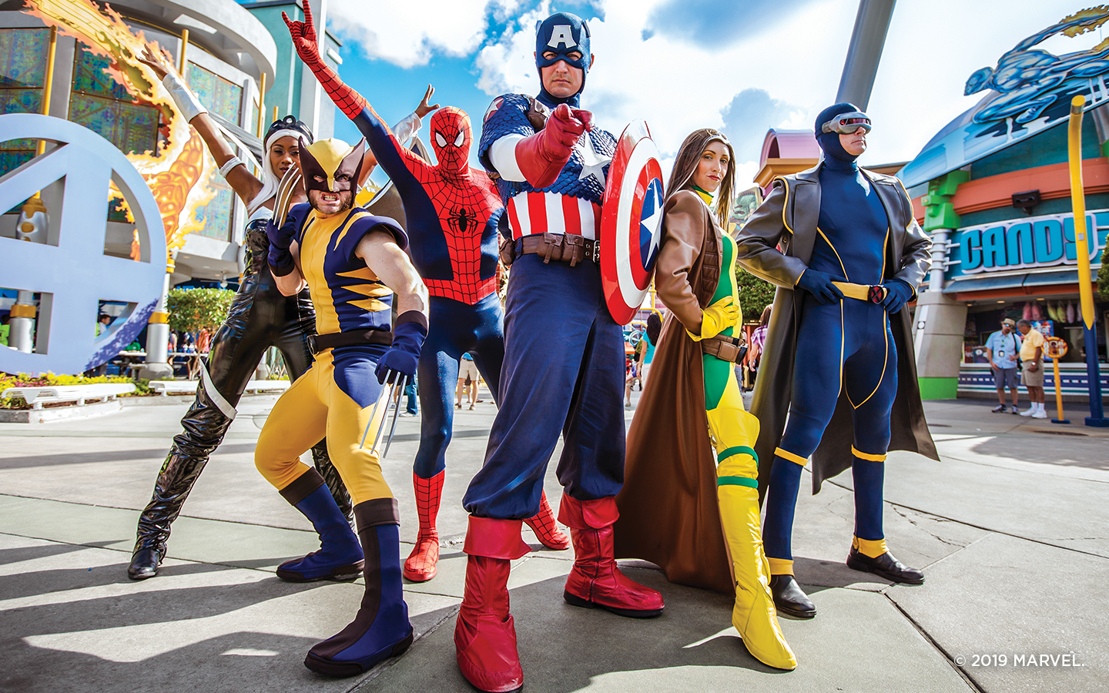

Overview of Venues Visited
Discovery Cove
SeaWorld
Main Event
Kava Tacos + Tequila
Tin Roof
Planet Hollywood
Universal Studios CityWalk
Universal Studios Marvel Superhero Island
SoundStage 21
Margaritaville

Slide 16
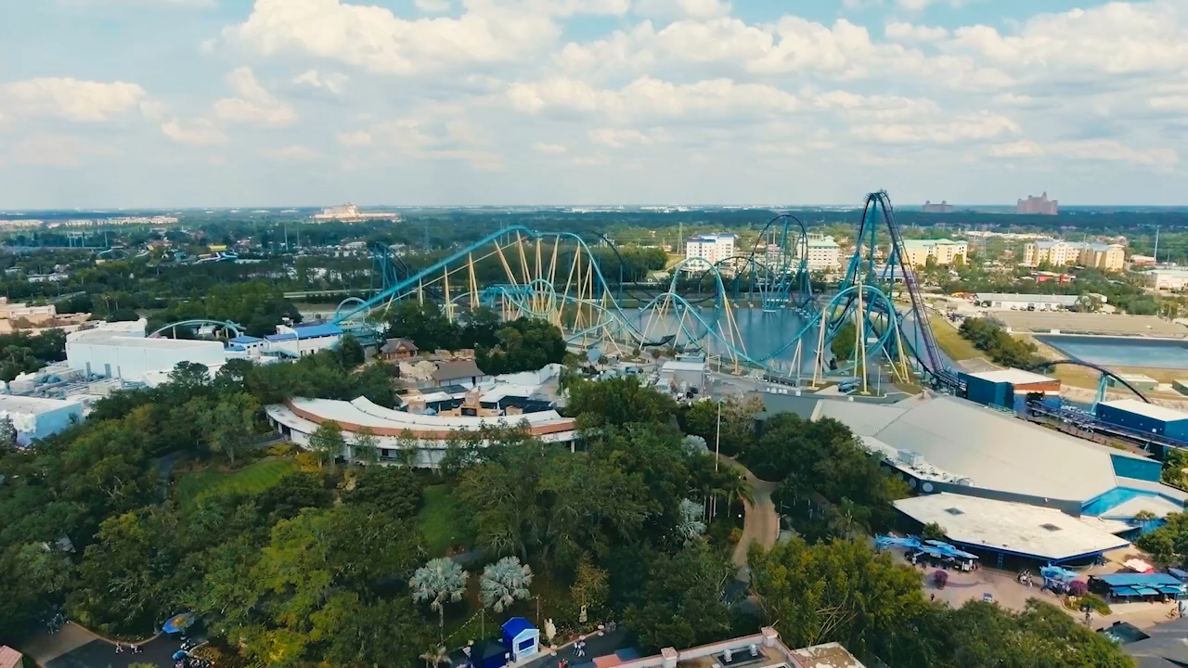

Slide 17
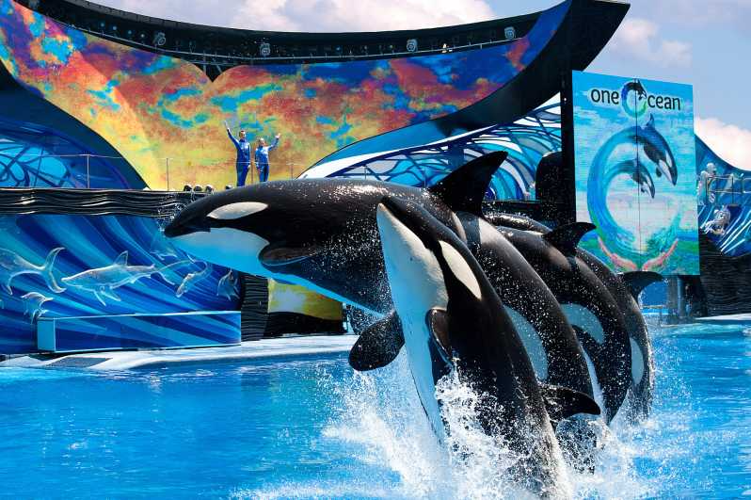

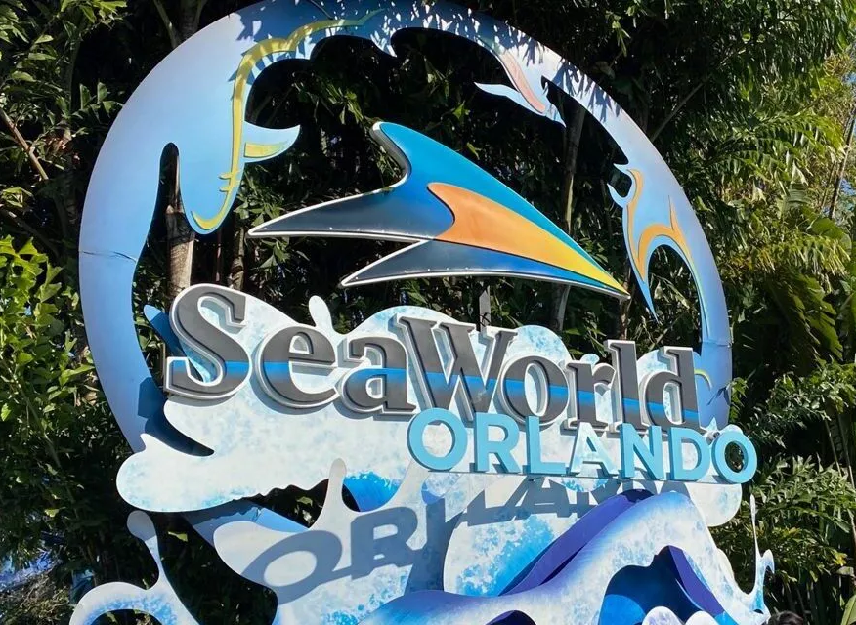
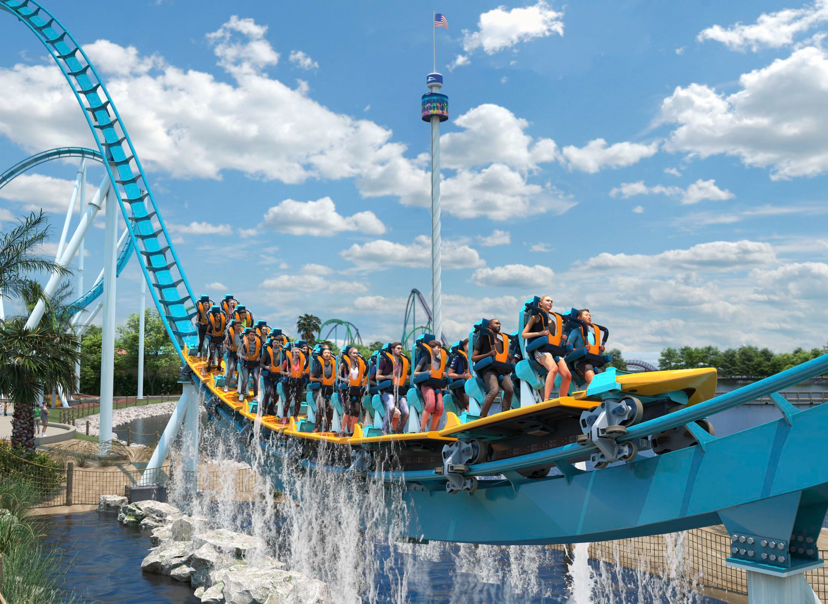

Slide 18
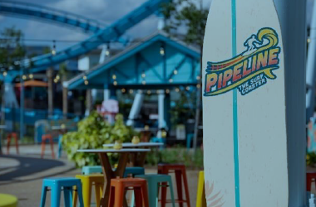
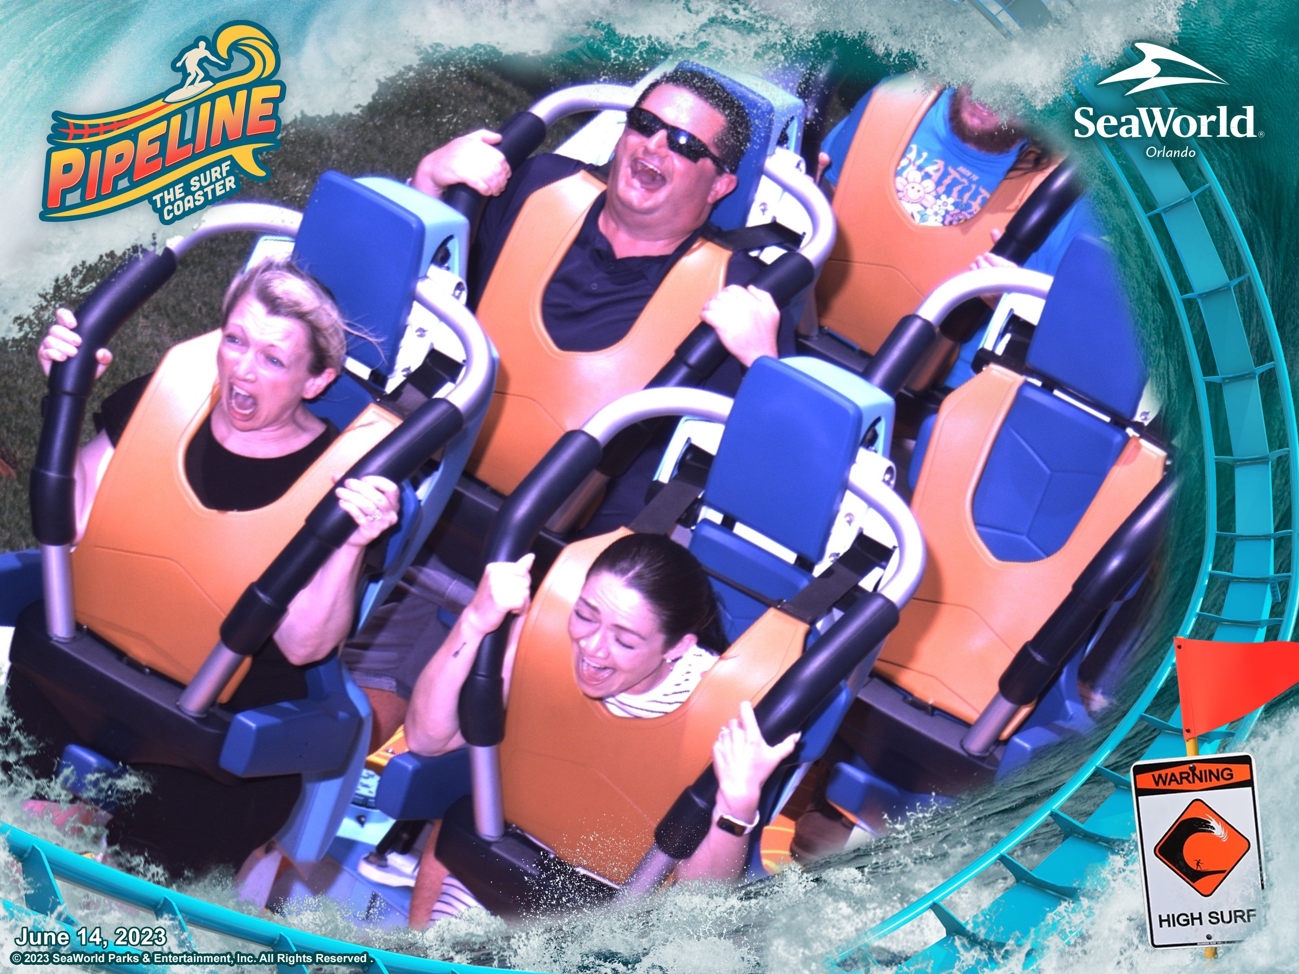
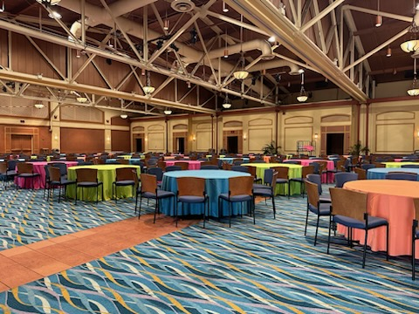
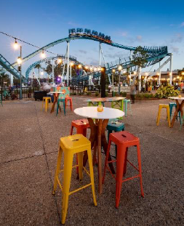


Opening Reception at Sea World
Emphasis on Orlando, FL vibes
Gives attendees an opportunity to go to SeaWorld
Private roller coaster rides on Pipeline (offers us a cheeky branding opportunity) and can brand the roller coaster photos
Private Orca show that gives attendees a taste of SeaWorld
DJ/Entertainment
Air-conditioned indoor space along with outdoor space
Bus drop-off at the entrance to our event space
Access to SeaWorld tickets at a discount

Slide 19
2024 Keynote & Emcee
Christin DeLuzio

Slide 20
Keynote & Emcee Evaluation Process:
1
2
3
4
Started in May and evaluated, reviewed, and ranked 25+ keynote speaker opportunities and 10 emcee options
Partnered with local and national speaker bureaus to help source opportunities and talent
Asked for keynote and emcee recommendations from sales and other leaders throughout organization
Ensure Recommendations Stay Within Connections Budget

Slide 21
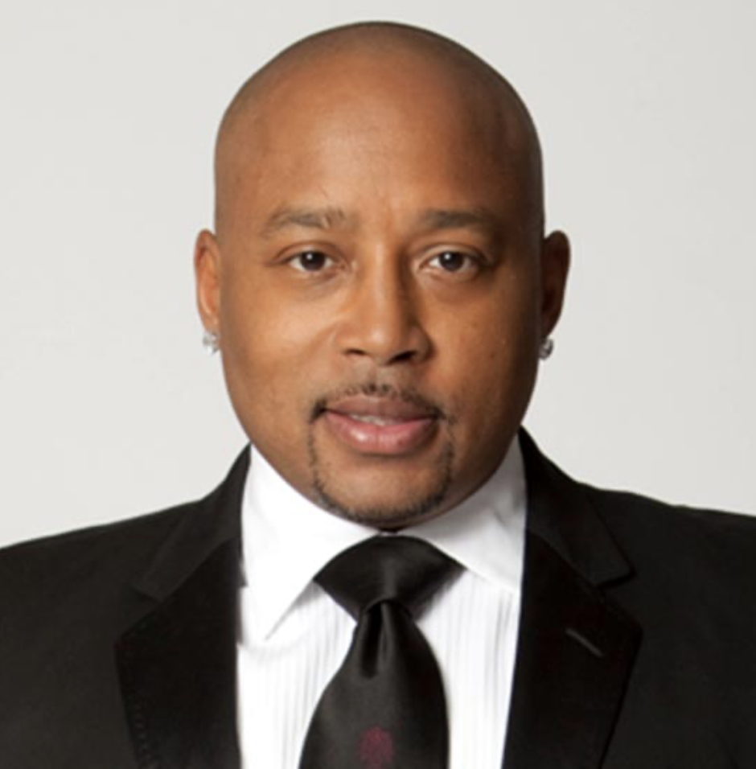


2024 Keynote Recommendation & Rationale
Daymond John
CEO of FUBU & Star of Shark Tank
  Daymond tells his rags-to-riches story, plus gives tips on how to have an entrepreneurial mindset
  He has several topics that he can speak about, and part of his service is to consult with us on the best message for our audience
  We feel that the mix of business owners, and those who are likely innovation-minded will enjoy his remarks
  Name recognition and sponsorship opportunities
Includes:
  70-75 minute keynote
  30 Minute VIP Meet & Greet
  Same cost regardless of using a bureau or direct

Slide 22
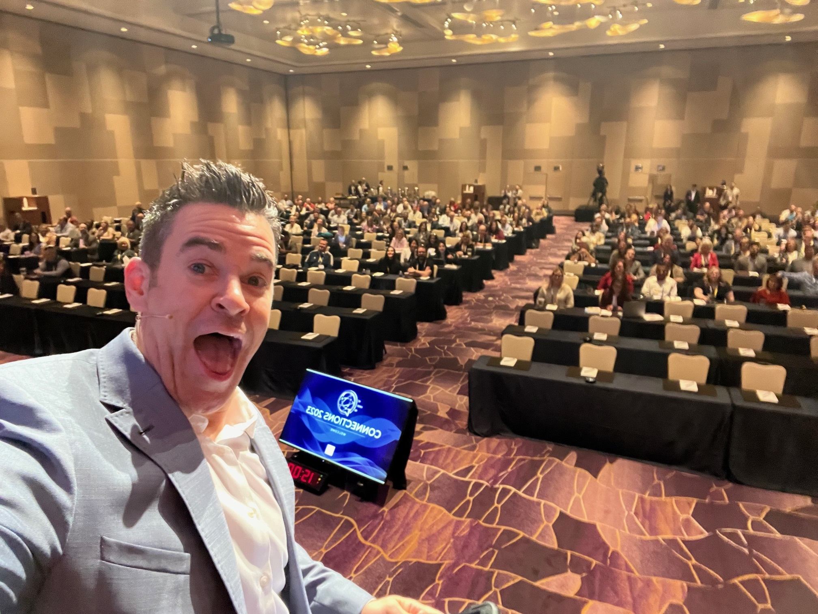
Why Use an Event Emcee?
Better Attendee Experience
High-Level Energy Throughout Event
Elevates Connections
Professionality & Continuity
Diversity & New Viewpoints

Slide 23
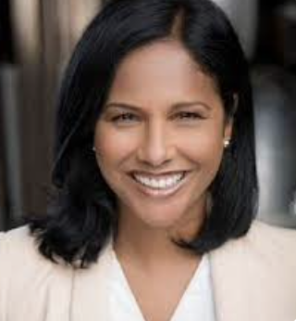
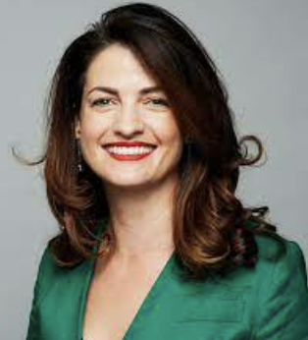
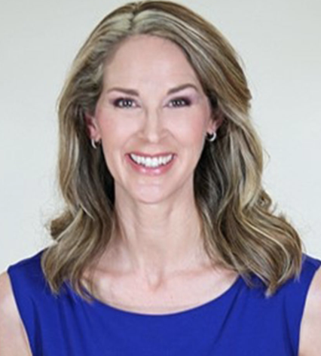
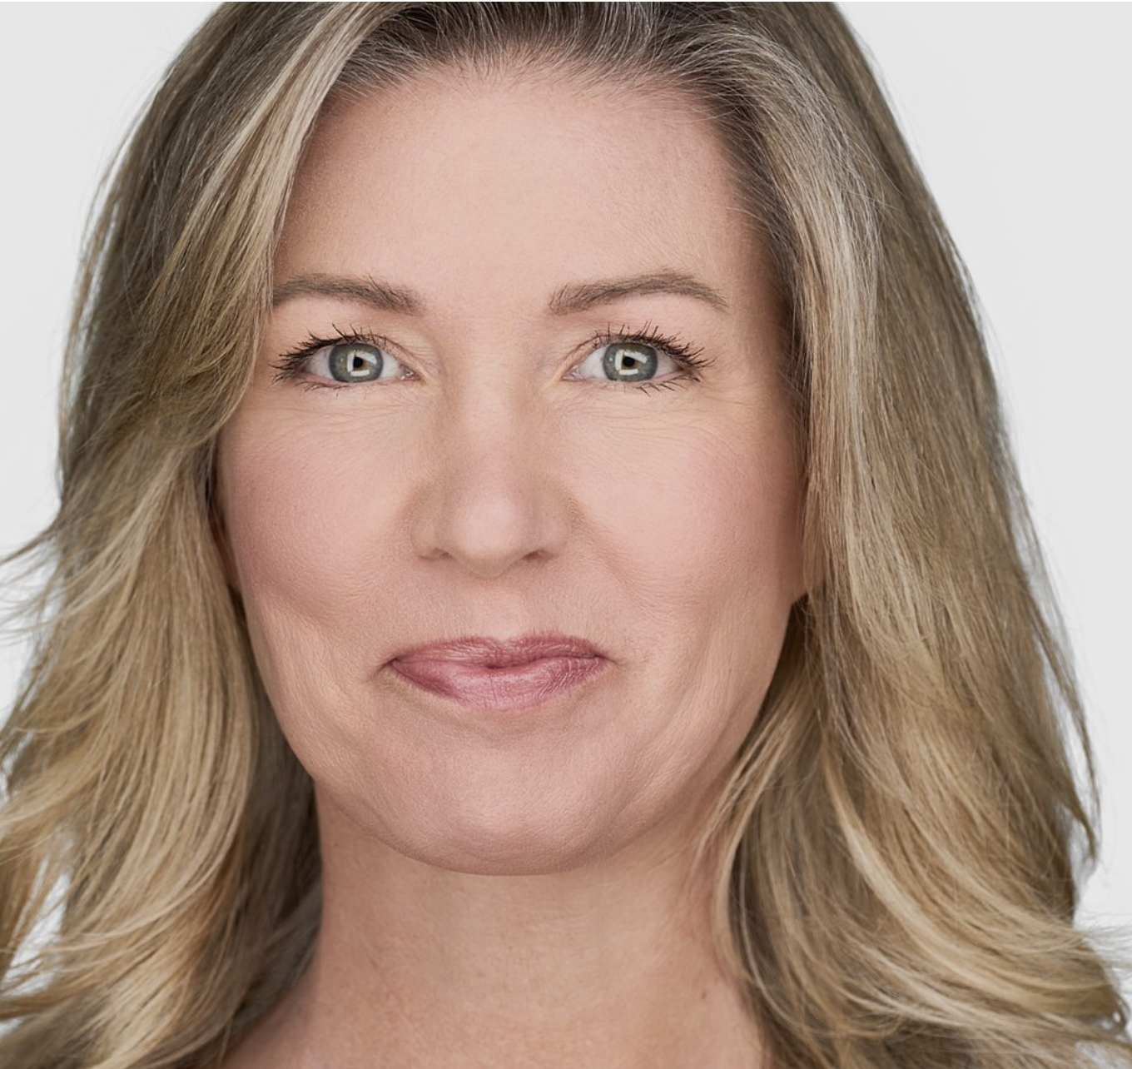
Emcee’s Current Being Evaluated
Eva Saha
Former Newscaster, Professional Event Emcee
Meggie Palmer
CEO of PepTalkHer
Women's Luncheon Keynote
Amy McWhirter
Professional Event Emcee
Christine Hofbeck
Former Survivor Contestant
VP of Fortitude RE
Includes (3) days and a dress rehearsal
Aiming to use the emcee for the Women's Luncheon

Slide 24
2024 Sponsorships
Christin DeLuzio | Sr. Event & Engagement Consultant

Slide 25
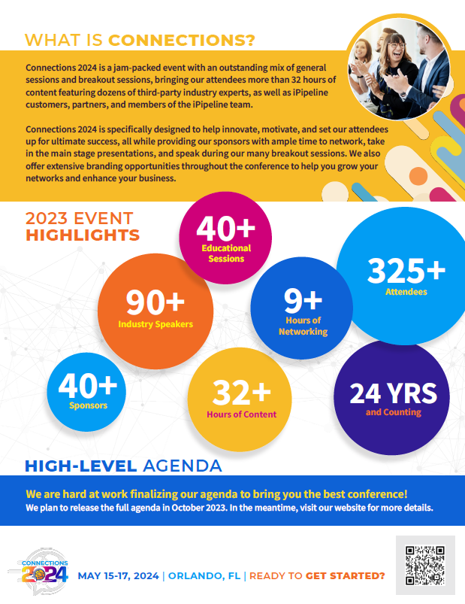
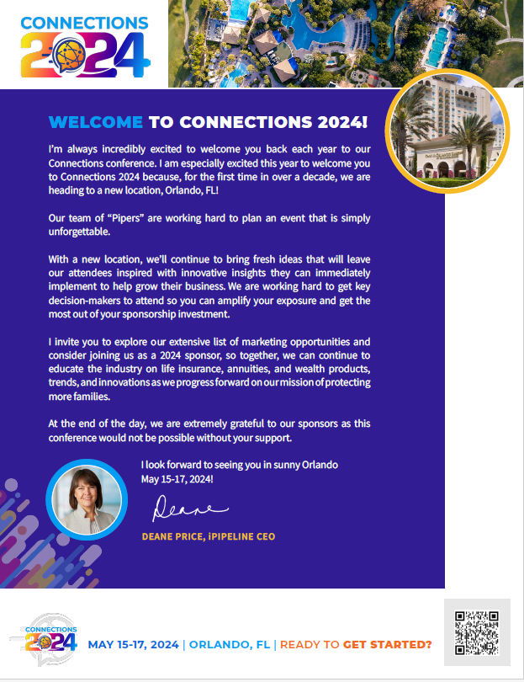
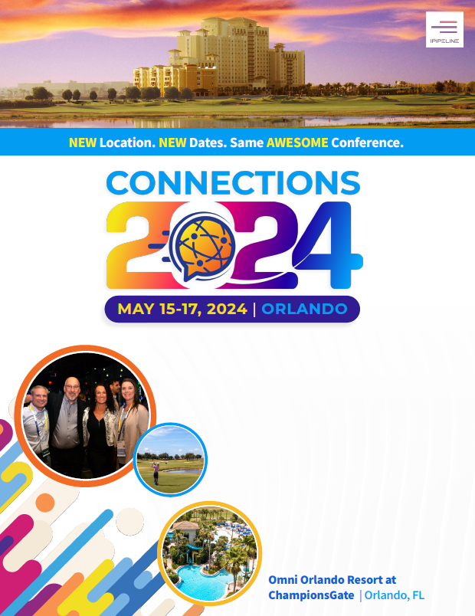
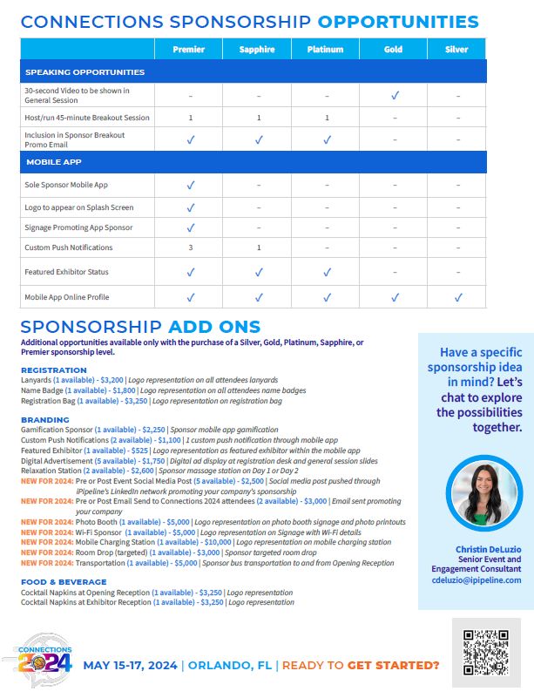
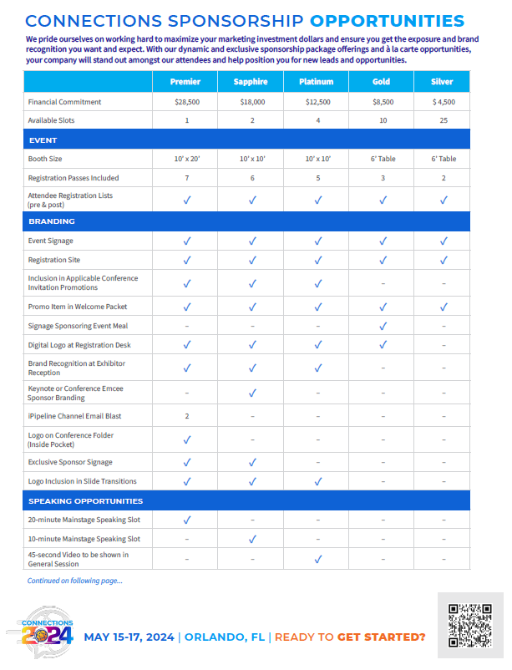
Sponsorship Update & Revamped Prospectus
Launching end of August!
Notes:
Third party’s cannot come unless they sponsor

Slide 26
Registration Launch & Timeline
Christin DeLuzio

Slide 27
Registration Launch Timeline & Upcoming Assets
September 15: Steering Committee Content Recommendation to Executives for Review
September 18 – September 22: Executives Review Content Recommendations and Provide Feedback
September 25 – September 29: Steering Committee Modifies Content Based on Executive Feedback
October 2 – October 5: Executive Team Final Review & Approval of 2024 Content
October 6 – October 20: Registration Site Build & Testing
October 20 – November 7: Marketing Finalizing Communications and Prepping for Launch
October 31 – November 3: Exclusive Connections Registration Launch at NAILBA – entered to win a spot at Daymond John’s VIP Meet and Greet at Connections
November 8: Launch Assets Become Available on SharePoint (Email Signature, Golden Ticket Codes, Promo Slide, Conference Agenda….etc.)
November 8: Registration Opens!

Slide 28
Registration Fees
New for 2024:
Increased fees for the first time in 15+ years
Past Fees:
BGA | $399
Carrier | $899
Financial Services/Wealth Management | $399
Partner/Vendor | $1,200
Notes:
Have not priced increased for Carriers/Distributors (vendors went up in 2023)

Slide 29
Questions?

